Slide 1
Coursera Capstone Project
The Battle of The Neighborhoods
Bobby Mohanty

Slide 2
Introduction
The purpose of this Capstone Project is to help people in exploring better facilities around their neighborhood. It will help people making smart and efficient decision on selecting great neighborhood out of numbers of other neighborhoods in Scarborough, Toronto.
Lots of people are migrating to various states of Canada and needed lots of research for good housing prices and reputed schools for their children. This project is for those people who are looking for better neighborhoods. For ease of accessing to Cafe, School, Super market, medical shops, grocery shops, mall, theatre, hospital, like minded people, etc.
This Capstone Project aim to create an analysis of features for a people migrating to Scarborough to search a best neighborhood as a comparative analysis between neighborhoods. The features include median housing price and better school according to ratings, crime rates of that particular area, road connectivity, weather conditions, good management for emergency, water resources both fresh and waste water and excrement conveyed in sewers and recreational facilities.
It will help people to get awareness of the area and neighborhood before moving to a new city, state, country or place for their work or to start a new fresh life.

Slide 3
Data Description
Data Link: https://en.wikipedia.org/wiki/List_of_postal_codes_of_Canada:_M
We will use Scarborough dataset which we scrapped from Wikipedia on Week 3. Dataset consisting of latitude and longitude, zip codes.
Foursquare API Data:
We will need data about different venues in different neighborhoods of that specific borough.
In order to gain that information we will use “Foursquare” locational information. Foursquare is a location data provider with information about all manner of venues and events within an area of interest. Such information includes venue names, locations, menus and even photos. As such, the foursquare location platform will be used as the sole data source since all the stated required information can be obtained through the API.
After finding the list of neighborhoods, we then connect to the Foursquare API to gather information about venues inside each and every neighborhood. For each neighborhood, we have chosen the radius to be 100 meter.
The data retrieved from Foursquare contained information of venues within a specified distance of the longitude and latitude of the postcodes. The information obtained per venue as follows:
1. Neighborhood
2. Neighborhood Latitude
3. Neighborhood Longitude
4. Venue
5. Name of the venue e.g. the name of a store or restaurant
6. Venue Latitude
7. Venue Longitude
8. Venue Category

Slide 4
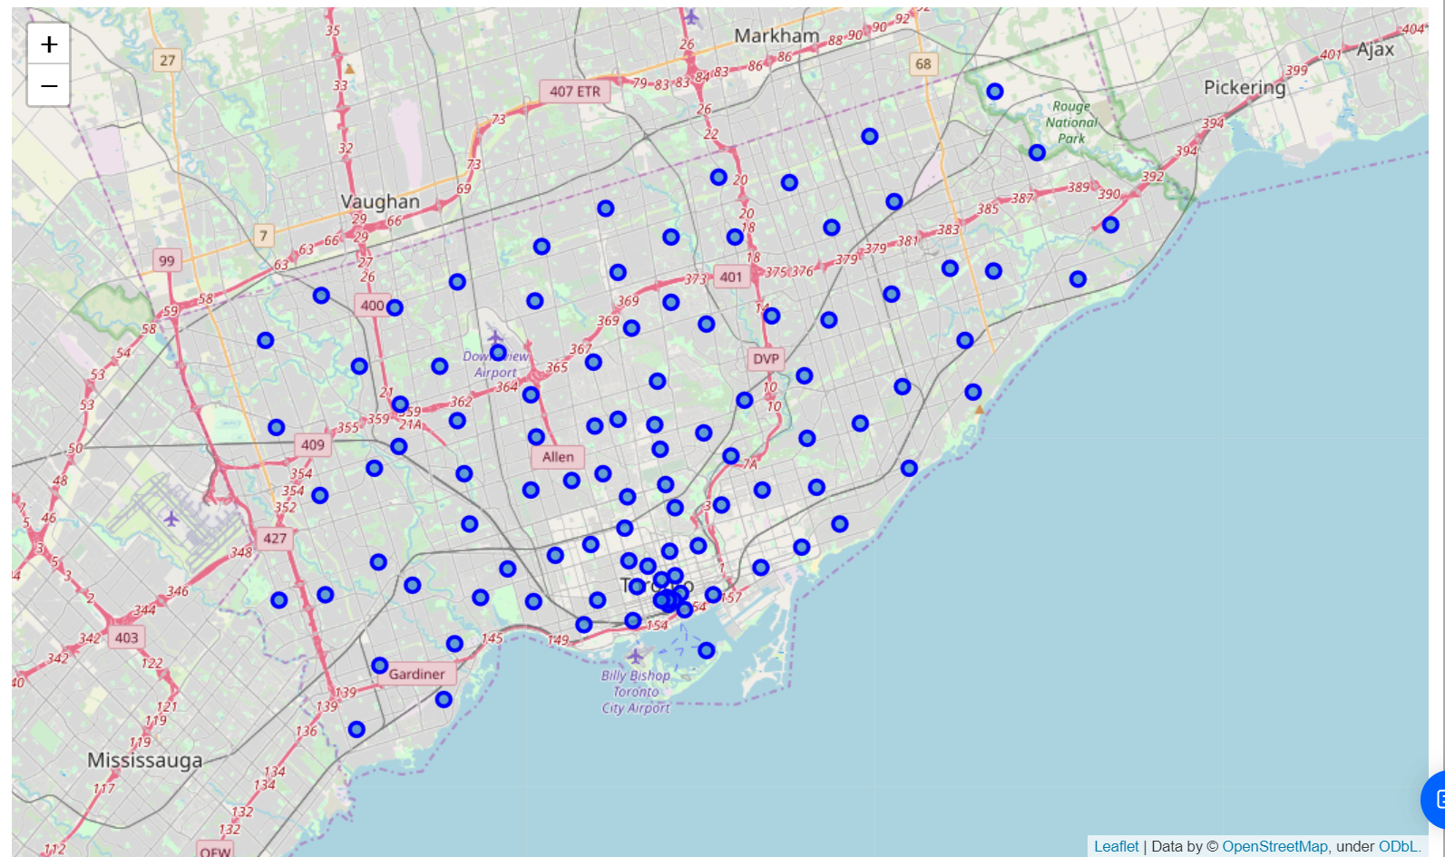
Map of Scarborough

Slide 5
Methodology
Clustering Approach:
To compare the similarities of two cities, we decided to explore neighborhoods, segment them, and group them into clusters to find similar neighborhoods in a big city like New York and Toronto. To be able to do that, we need to cluster data which is a form of unsupervised machine learning: k-means clustering algorithm

Slide 6
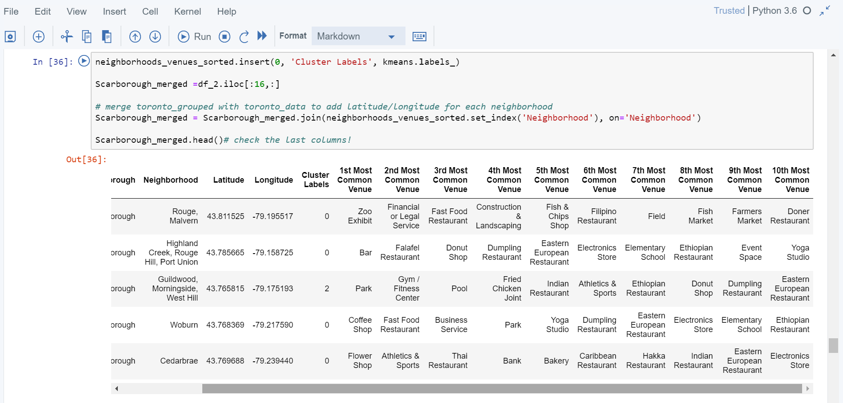
Using K-Means Clustering Approach | Most Common Venue

Slide 7
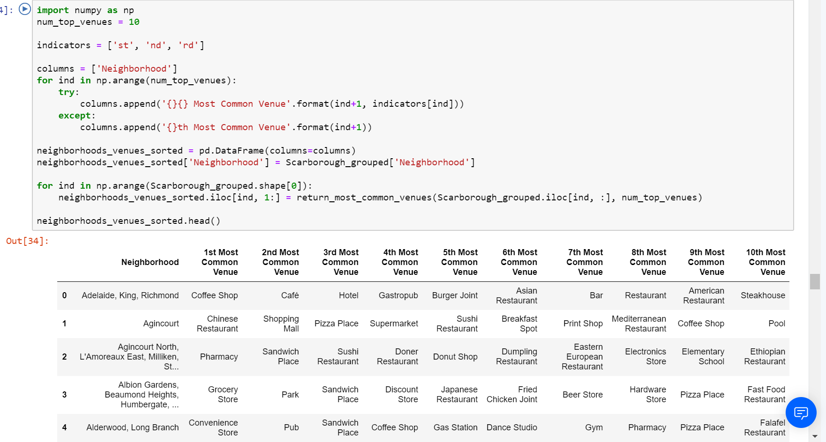
Most Common Venues near Neighborhood | Using Clustering

Slide 8
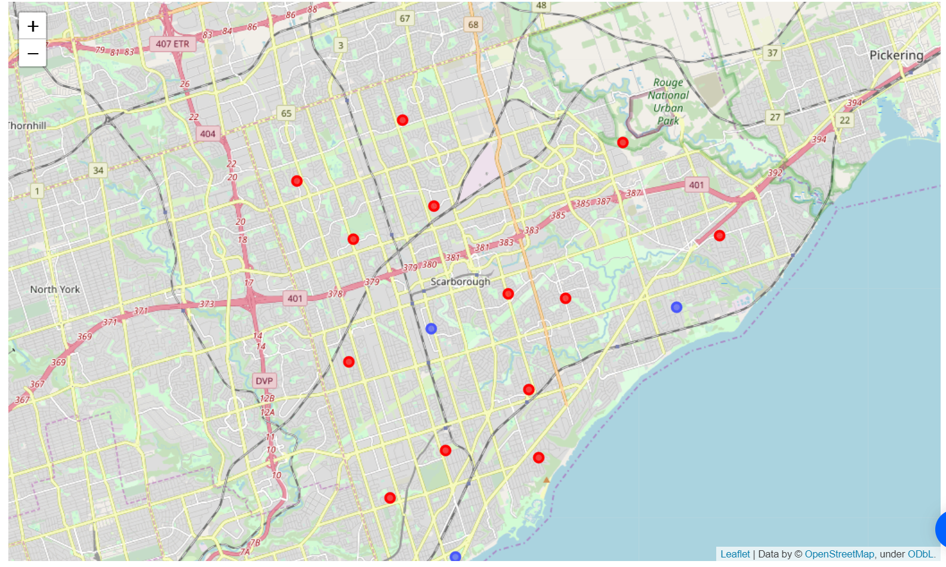
Map of Clusters Similar Neighborhoods in Scarborough

Slide 9
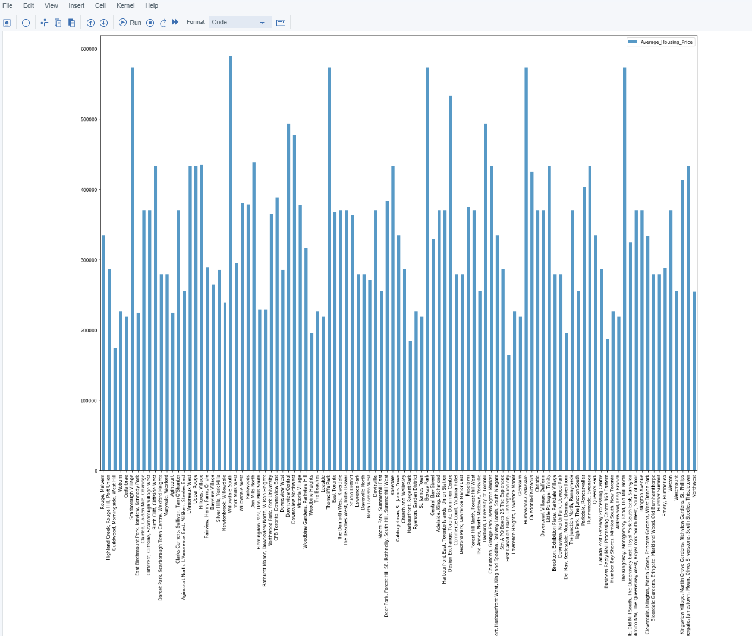
Average Housing Price by Clusters in Scarborough
Highest / Costly neighborhoods - Willowdale South and Scarborough village
Lowest / Cheaper neighborhoods - First Canadian place and Underground city

Slide 10
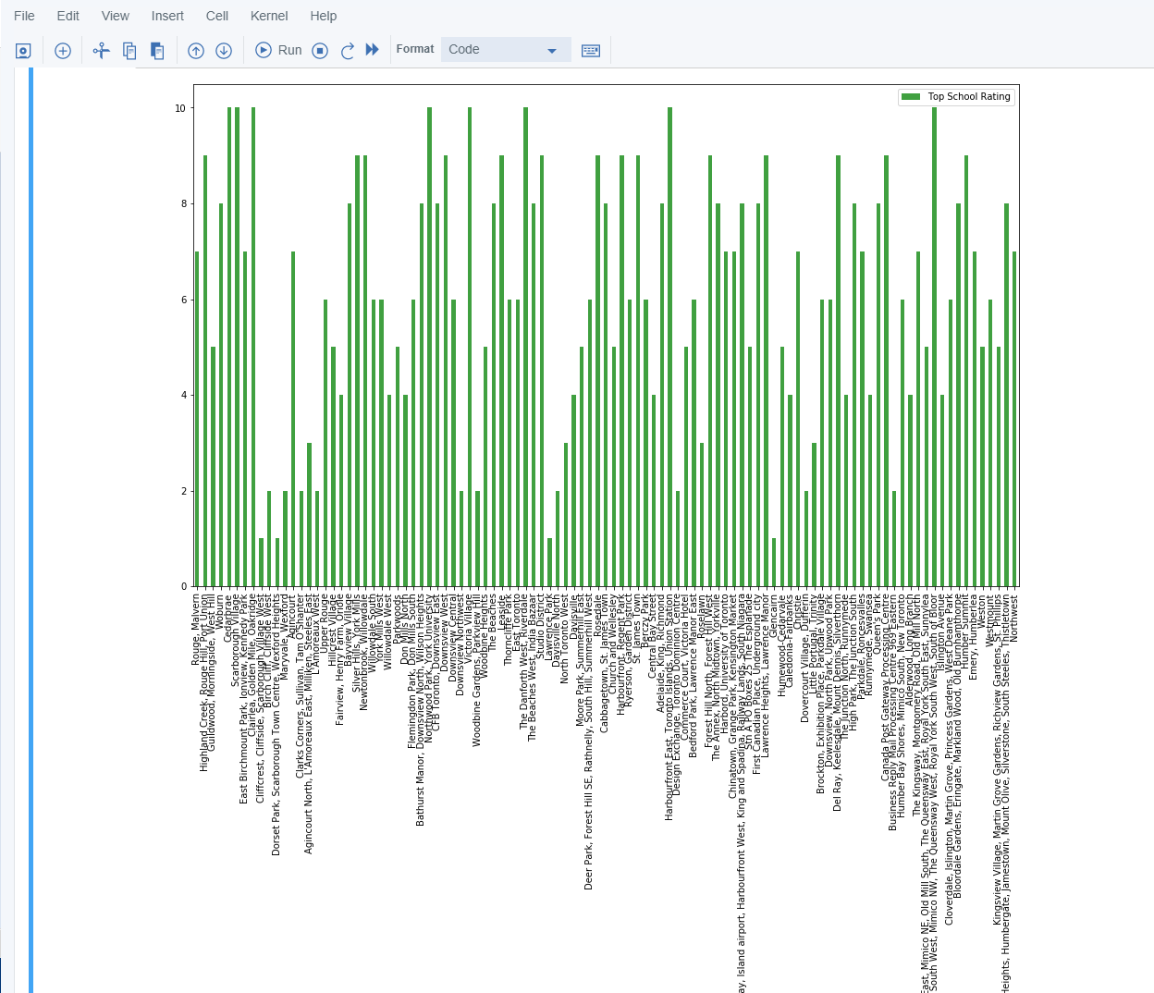
School Ratings by Clusters in Scarborough
Best rated School - 13 Schools including Scarborough High School and Wentworth school
Least rated School - 4 schools including Pleasant hill School

Slide 11
Conclusion
In this project, using k-means cluster algorithm I separated the neighborhood into 10(Ten) different clusters and for 103 different latitude and longitude from dataset, which have very-similar neighborhoods around them. Using the charts above results presented to a particular neighborhood based on average house prices and school rating have been made.
To answer the problem statement
1. The housing price of the neighborhoods:
Highest / Costly neighborhoods - Willowdale South and Scarborough village
Lowest / Cheaper neighborhoods - First Canadian place and Underground city
2. The rating schools of Scarborough
Best rated School - 13 Schools including Scarborough High School and Wentworth school
Least rated School - 4 schools including Pleasant hill School
The mapping with Folium is a very powerful technique to consolidate information and make the analysis and decision better with confidence.
Future Works:
This project can be continued for making it more precise in terms to find best house in Scarborough. Best means on the basis of all required things (daily needs or things we need to live a better life) around and also in terms of cost effective.

